Slide 1
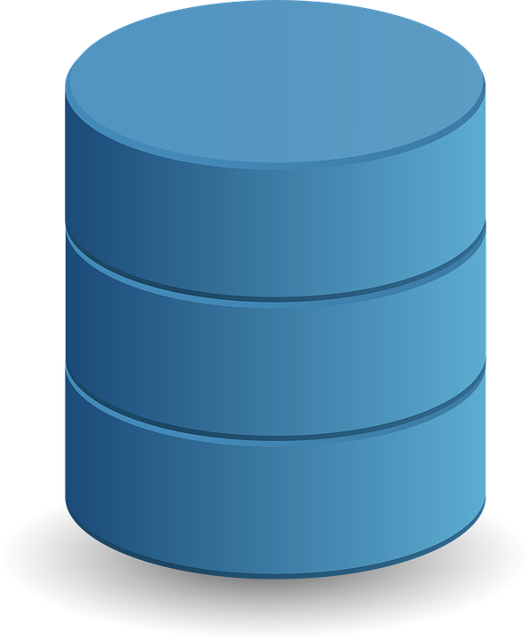
Introduction to Database management system
By Parul madan(ap)
Cse(geu)

Slide 2
What is data?
Data is basically row facts and figures that can be stored or recorded.
Can be quantitative or qualitative
Describe a variable or set of variables
Essentially data can be thought of a result of observations based on things like: measurements ,statistics.

Slide 3
What Is information?
By relating different data we are able to extract valuable information
For that we need to :
Store data : so that it can persist
Structure data : so that it is easier to manipulate
Organize data: in a meaningful way
Process data: to derive data from it

Slide 4
Data in secondary storage
Data is sometimes need to remain available even beyond the life of the program
In that case data is stored in secondary storage device like hard disk

Slide 5
files
When data is stored in secondary storage it is bound to reside in a file
File is an operating system concept, which makes separation among bundles of heterogenous data stored in the storage.

Slide 6
What is database?
A software application most of the times require to store relevant info in the secondary storage(in the form of files)
A database is a place where all your application related data is stored.
One application data can be stored in bunch of files.
In physical terms: Database is a collection of files
In logical terms: Database is a collection of tables.

Slide 7
Types of database
Text +numbers->traditional database
Collection of videos ,audios , speech->multimedia database
Collection of images->geographic info system
Info about stocks in departmental store->real time database

Slide 8
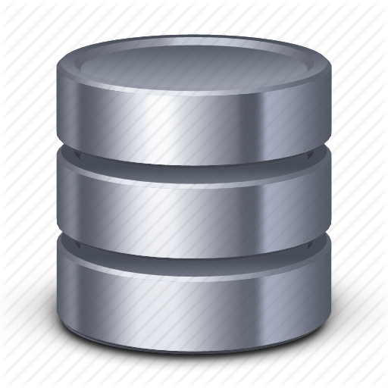
What is file handling?
Files need to be handled by set of programs
This bunch of programs is a part of actual application.
Database
Business Logic
User Interface
File handling
Secondary Storage

Slide 9
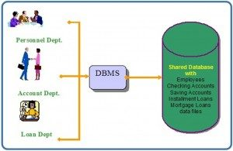
What is dbms?
The DBMS is general purpose software system that facilitates the process of defining, constructing, manipulating and sharing databases among various users and applications.
A DBMS is a collection of interrelated data and a set of programs to access those data .The collection of data usually referred as database, contain information relevant to enterprise.
Primary goal of DBMS is to provide a way to store and retrieve database information that is both convenient and efficient way.

Slide 10
Characteristics of database
It provide data services to applications
Efficient data querying and update mechanism
Data-integrity guarantees data is always right even in the case of software and hardware errors.
Other backups ,compression ,security and replications etc.

Slide 11
Applications of database
Banking: all transactions
Airlines: reservations, schedules
Universities: registration, grades
Sales: customers, products, purchases
Online retailers: order tracking, customized recommendations
Manufacturing: production, inventory, orders, supply chain
Human resources: employee records, salaries, tax deductions

Slide 12

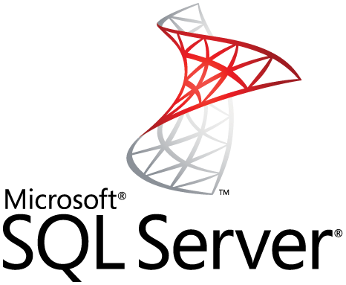

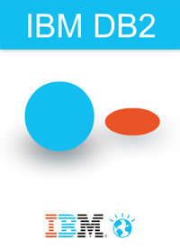
Well known dbms include:

